Slide 1






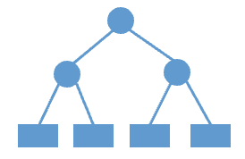



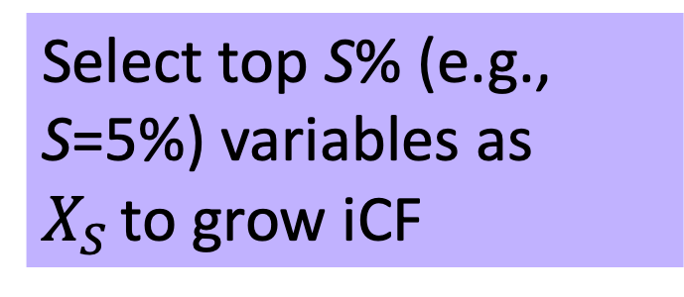
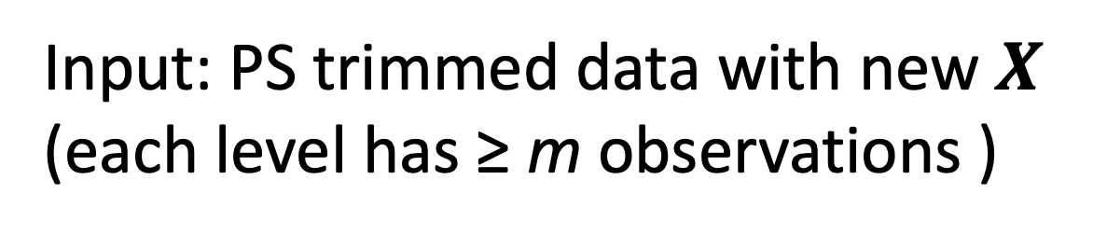
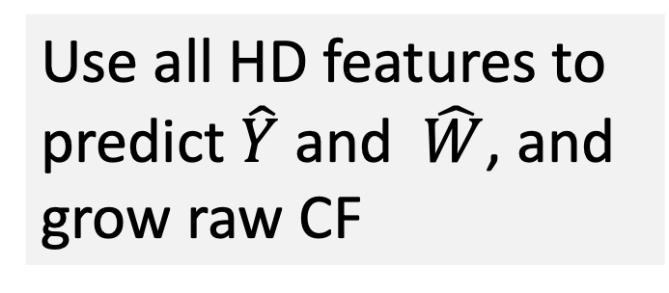
Generate HD variables
$$\text{PS} \text{trimming} \text{and} \text{HD} \text{feature} \text{preparation}$$
Input: data
K variables
Predict PS with all HD features
Output: $\hat{W}$
$$\text{Implementation} \text{of} \text{iCF}$$
Zero: 0
Input: data$,\hat{W}$
Once: 1
Sporadic: 2 ≤ and ≤ 75th percentile
Frequent: > 75th percentile
PS trimming: remove non-positivity regions
Input: $\text{PS} \text{trimmed} \text{data} \text{with} \text{new} X$ (each level has ≥ m observations )
$$\text{HD} \text{feature} \text{identification}$$
Output: PS trimmed data
iCF
0 1 2 3
Input: PS trimmed data
G_{iCF}
Identify covariates: n=200 most prevalent codes (3 digits for ICD-10 codes, 5 digits for CPT codes, and 3rd level of ATC codes) from the p=5 dimensions in healthcare claims data
HD feature preparation: combine the level with a low count (< m) with the next level with a higher count until each level has ≥ m observations.
Use all HD features to predict $\hat{Y}$and $\hat{W}$, and grow raw CF
All HD variables
+
Rx
age, sex, race
Input: PS trimmed data with new $X$
Select top S% (e.g., S=5%) variables as $X_{S }$to grow iCF
Inpatient Diagnosis
(ICD-10)
Inpatient Procedure (CPT)
Outpatient Diagnosis (ICD-10)
Outpatient Procedure (CPT)
Drug dispensing
(ATC)
Subtract all prevalences that are larger than 0.5 from 1.0
Require prevalence > cutoff c (e.g., 1%)
Input: data
Obtain subgroup decisions
K variables
Predict PS with all HD features
G_{iCF}
0 1
Output: $\hat{W}$
Cross-validation to obtain the best subgroup decision
≥ Once:
Input: data$,\hat{W}$
0 1
Variable selection based on Bross formula
PS trimming: remove non-positivity regions
Sporadic: ≥ median
Output: subgroup decision$\text{G}\text{iCF}$
0 1
Output: PS trimmed data
Frequent: ≥ 75th percentile
Input: PS trimmed data
0 1
Selected HD variables
0 1
HD feature preparation: assign the value to 0 for those with a low count (< m).
+
age, sex, race
0
Input: PS trimmed data with new $X$

